Slide 1


Addressing Computational Burden to Realize Precision Medicine
Can Alkan
Department of Computer Engineering
Bilkent University
Ankara, Turkey

Slide 2
Problem
Very high amounts of overlap with Onur Mutlu’s talk

Slide 3
Solution
Ditch the title, pick another direction.
Sorry for all the text…

Slide 4
Addressing Computational Burden for Low-Priority Genome Analyses
Can Alkan
Department of Computer Engineering
Bilkent University
Ankara, Turkey

Slide 5
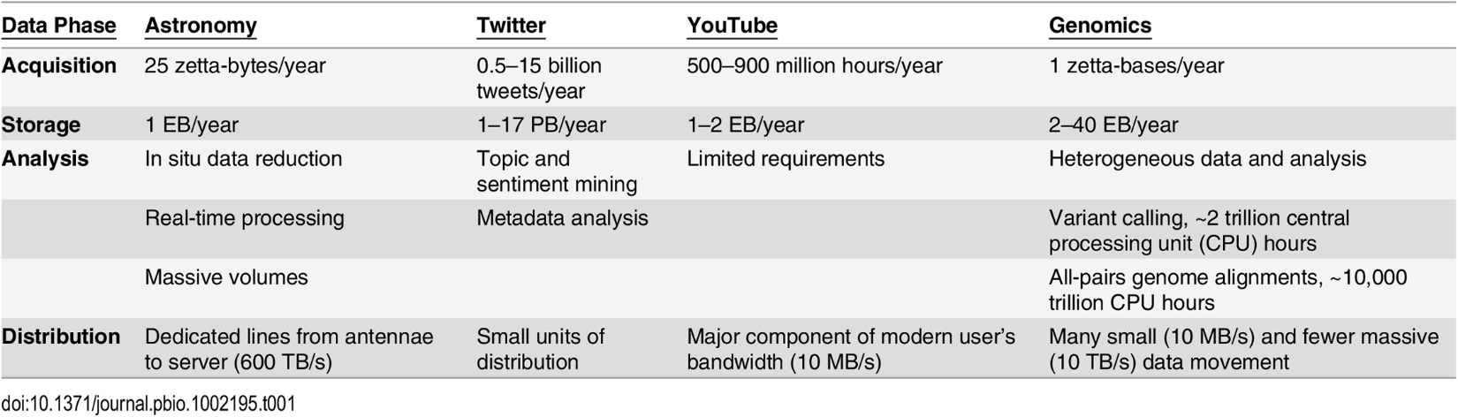
Genomics: the new Big Data
Stephens et al. PLoS Biology, 2015

Slide 6
Need for speed varies
High
(Urgent) clinical seq.
Diagnosis
Treatment guidance
Infection control
Species/subspecies
Antibiotic resistance
Virus profiling
Coinfection
…
Moderate
Other clinical
Tumor profiling
Cancer subtypes
Drug resistance
Rare disease diag.
Research
Genotype/phenotype
Causal mutations
Population genomics
Evolutionary biology
De novo assembly
….
Low
Re-analysis
New reference
…
HPC, accelerators,
embedded devices…
Cloud, clusters, HPC,
advanced workstations,…
Cloud, clusters,
grid computing

Slide 7
Diverse analyses
Read alignment
Different optimizations for
data from different platforms
SNP/indel/SV discovery
Transcriptome
Assembly
Expression
Epigenetics
ChIP-seq
Methyl-seq
De novo assembly
Scaffolding
Annotation
Comparative genomics
Homology maps
Metagenomics
Species / subspecies identification
Antibiotic resistance
Single-cell genomics/transcriptomics
…

Slide 8
HTS read alignment
Aligning HTS reads is a compute intensive task
>35 CPU days per 30X genome using BWA-MEM + sort + mark duplicates
~18K human genomes / year can be sequenced using HiSeqX Ten
630K CPU days = ~1800 CPU years per HiSeqX Ten
Single NovaSeq: 7200 genomes/year
Estimated 1 million genomes by the end of 2017
35 million CPU days = ~100K CPU years for alignment only

Slide 9
HTS read alignment (2)
Additionally, reference human genome gets an update every 3-4 years
Fixes minor alleles
Fixes collapsed duplications
Fixes contig orientation (i.e. incorrect inversions)
Adds new sequence
For better reliability it is best to remap existing data to new reference
All 1000 Genomes Project data are remapped to GRCh38

Slide 10
Remapping old, or mapping new?
Large clusters are not infinite resources
While remapping old data, more new data are generated, which typically have higher priority
Computational burden keeps increasing
Proposal: volunteer grid computing

Slide 11
Volunteer grid computing: BOINC
Berkeley Open Infrastructure Network Computing
Volunteers download “problem sets” from the server, solve them in “spare time”, upload results back
Made popular with the SETI@home project
Some bioinformatics applications are ported (Rosetta@home, RNAworld, DENIS@home)
Total computational power of 22.08 PetaFLOPS.

Slide 12
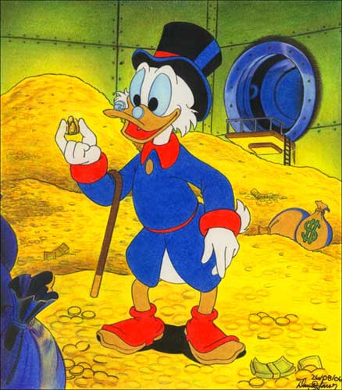
Read mapping w/BOINC
Data privacy, making sure the alignments are correct, other potential problems
Main Problem: HTS read mapping uses more compute resources on CPU, RAM, and disk. More unlikely for volunteers to dedicate such resources
Solution: Motivating volunteers

Slide 13
Current solutions
Gridcoin: A cryptocurrency wrapping around BOINC to reward volunteers, on top of Proof-of-Stake
Limited to BOINC projects.
FoldingCoin: Distributing reward tokens to participants of Folding@home network
Sibling projects with CureCoin
A smart contract on top of Bitcoin
A wrapper on an existing project. Not extensible

Slide 14
What is needed?
Rewarding Read Alignment
Attracting new participants
From other currencies: ASIC miners
Novice users: CPU volunteers
Extending a cryptocurrency, do not restructure
Take advantage of immutability, decentralization
Notes:
To achieve these goals, we should know what a blockchain is; its properties and capabilities. So, next slides are for this purpose.

Slide 15
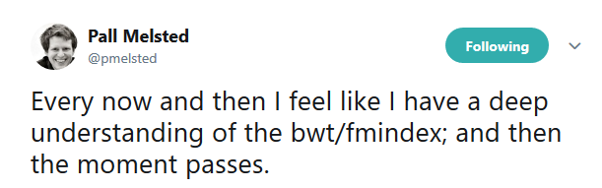
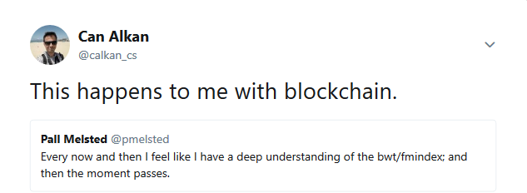
Blockchain: what is it?

Slide 16
Blockchain: what is it?
A consensus protocol between multiple parties that tackles the action (transaction) ordering problem.
This problem is called “double-spending” in financial terms.
Highly suitable for decentralized monetary systems
Provides:
Consensus on the order of actions
Immutability: historical records cannot be altered
Incentive for contributors: mining rewards
Decentralization

Slide 17
Blockchain – How does it work?
Public Ledger
Synchronized among participants
At each T period, a new block is estimated to be generated
Blocks carry transactions
Block generation should be difficult enough, so that it takes T amount of time to be found
Transactions define the state of the world
Who owns how much currency
Block creators are called Miners, they are rewarded for their contribution and competition that provides immutability.

Slide 18
Blockchain – How does it work?
Longest Chain Wins
More work is required to produce more blocks
All participants agree with whomever provides higher number of blocks
Two Parts:
Mining: Generation of new “block”s
Transaction: “State transition”
Transactions change the state of the database. They can be regarded as Create-Replace-Update-Delete (CRUD) operations.
This is important understand that Blockchains are actually capable of running any piece of software, e.g. Ethereum Smart Contracts
Notes:
“Longest chain wins” is the most important rule. It is the most basic consensus rule between peers. Whoever creates more blocks or has more blocks, they convince others to use their version of blockchain.

Slide 19
Cryptocurrencies
Digital “money” that uses cryptography to ensure security in transactions and to control creation of new units in a decentralized environment.
Blockchain is the underlying structure of most Cryptocurrencies
Bitcoin, Ethereum, Ripple, etc.
Not ALL Cryptocurrencies use blockchain.

Slide 20
Bitcoin
Most popular cryptocurrency, first blockchain
Invented in 2008, open-source software in 2009
Blockchain is the database of financial transactions
Completely decentralized
In 2013: 2,798,377 GH/s
As of Thursday: 25,265,139 TH/s

Slide 21
Surge of popularity
Cryptocurrencies gained immense popularity in 2017
Speculations of price and bubble rumors cast a cloud on Blockchain technology
Scam, get-rich-quick applications => Bad Taste
ICO, instead of real funding
Lack of regulation leads to malevolent actions
Slowly getting back in track
Notes:
Here, we should briefly mention what happened in 2017 and how it affected the blockchain technology

Slide 22
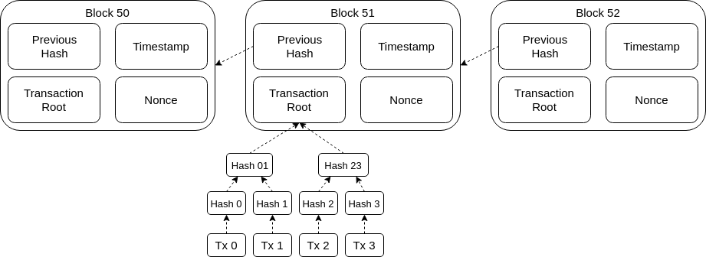
Bitcoin blocks
Notes:
Here you can see the basic components of a block and how blockchain is connected.
In this figure, what we show as “block” is actually the block header.
A block’s hash only calculated by the header part.
Transactions are included as a merkle tree. Only root of the merkle tree is included in block’s header.
Every block is connected to an earlier block by having its hash.

Slide 23
Proof-of-Work: Nonce
Finding a valid nonce is a difficult job
It is supposed to be this way for immutability.
Bitcoin, Ethereum (currently), Litecoin still use this technique.
However, this nonce computation gets only harder and requires more computation resource as the network grows
Current solutions:
Proof-of-Stake, Proof-of-Space, Tangle, Ripple
Notes:
I dont think we need to provide details for current solutions. You can mention that all these methods almost completely removes the unnecessary computation. However they are not adopted massively due to their shortcomings and current miners do not wanna give up on their mining rigs :P

Slide 24
Blockchain summary
Helps to maintain a decentralized database of action records between any number of peers
Maintains a consensus
However, proof-of-work is expensive and has no practical use outside of the blockchain environment
Miner incentivization is focused on proof-of-work
No practical way to shift computation towards a real world application

Slide 25
Blockchain in Genomics
Genomics Data Market suffer from privacy concerns
Third parties should not own genomic data
Individuals would feel comfortable having control
Blockchain solutions provide:
Private and secure storage options
A decentralized environment between gene donors and scientists
Genechain, Zenome, Nebula Genomics
Notes:
First 3 bullet points are the same idea behind all genomic blockchain startups
Cut out the in-between companies like 23andMe, make you the real owner of your personal genomic data
You can resell this data on blockchain. Secure storage is provided by god knows who?
none of these solutions can work 100% with blockchain. Nebula genomics are still saying that someone needs to sequence an individual's genome and return back the results. How the hell is this decentralized? The only way to really decentralize such a problem is one day people will be able to sequence a genome at home.

Slide 26
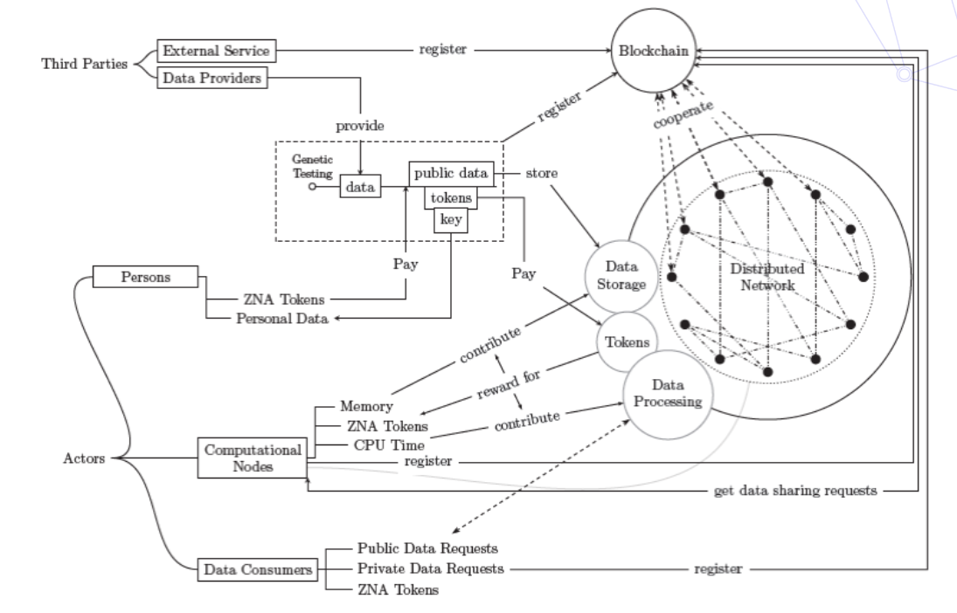
Zenome
Provide a decentralized environment for individuals to store and share their genomic data
Reward donations with Zenome Tokens
Blockchain is the medium of tokens and smart contracts that govern the entire ecosystem

Slide 27
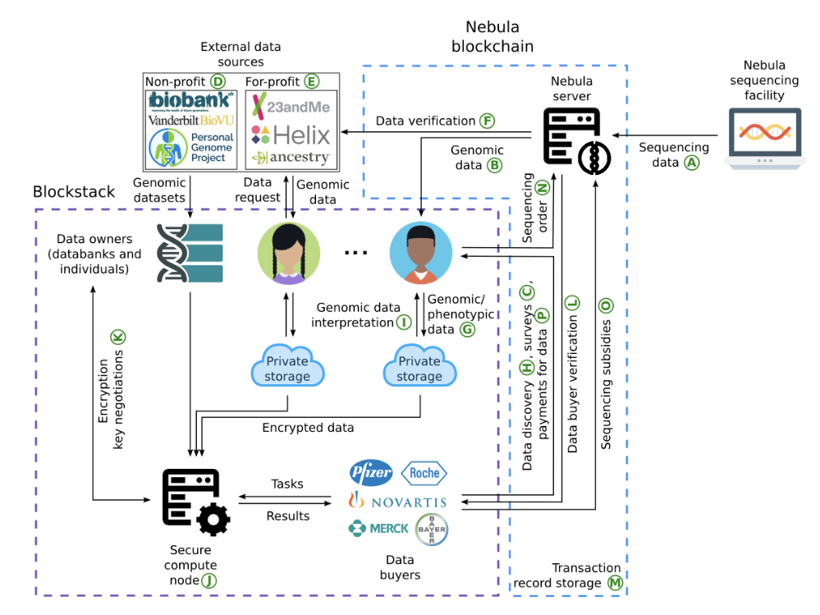
Nebula Genomics
Cheap sequencing service
Even getting paid for it
Eliminating 3rd parties between donors and pharma companies
Completely secure and private compute nodes
Build on top of existing technologies
Blockstack
Enigma

Slide 28
Proposal: Coinami
A way to distribute Read Alignment problem on a voluntary computational grid by using Blockchain as a medium for rewarding and decentralized job distribution
Layered authority structure
Coinami utilizes bitcoin structure as basis blockchain
Only spend and mint transactions
It adds new transactions as an extension to facilitate sub-authority registration, job distribution and rewarding.

Slide 29
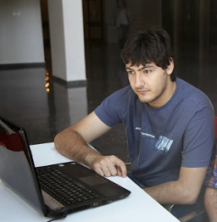
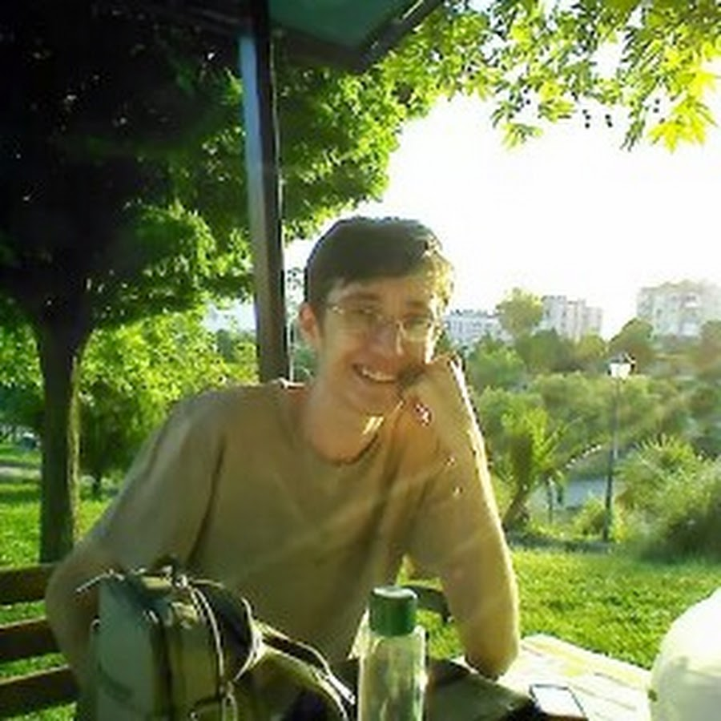
Undergrad(ish) power
Atalay Mert Ileri
Idea, protocols
Introduction to Research course project
Halil Ibrahim Ozercan
Lead Developer, Bitcoin enthusiast
Senior Design Project
Now: MSc student
No grad students were harmed until Halil decided to stay for grad school

Slide 30
Definitions
Job
Read Alignment Task
Main Authority
Single authority, CA. Responsible for accepting new sub-authorities. Hardcoded to client
Sub-Authority
Appointed by Main Authority.
Starts with a supply and job hosting address
Dumps jobs and rewards users
Miner
Works on proof-of-work, creates new blocks
Rewarded by coinbase transaction
Power
Deposits some coins to be selected for job assignment
If assigned, downloads and works on Read Alignment jobs from sub-authorities
Notes:
I think we didnt cover what a coinbase transaction in blockchain part. You can just say that it is the first transaction in every block, which has no input. It is addressed to miner’s wallet.

Slide 31
Coinami features
Not decentralized, but layered-structure
Read Alignment problem requires a publishing source (university, research center)
Multiple sources are on a level playing field
Sub-authorities are not responsible for distributing tasks
Read Alignment is privacy-sensitive, needs care while sharing with 3rd party
Blockchain can help to decentralize this process
Jobs are published with their reward values set. (Possibly depends on size)
Power users show their intention to work by putting stake in job pool
Assignment is calculated by Maximum Bipartite Matching
Notes:
I couldnt explain 3rd party job distribution. What I’m trying to say is that job assignments must be open to everyone. Decentralization of this process on blockchain is really simple.

Slide 32
Coinami features
Coinami includes both:
Read Alignment
Traditional mining
If miners earn more money than powers in the same time period, it would cause a shift from powering to mining, or vice-versa
To prevent this, Coinami allocates a dynamic block reward that matches the average earnings from powering
This would encourage miners to also participate in powering if it decreases, to eventually increase the mining reward

Slide 33
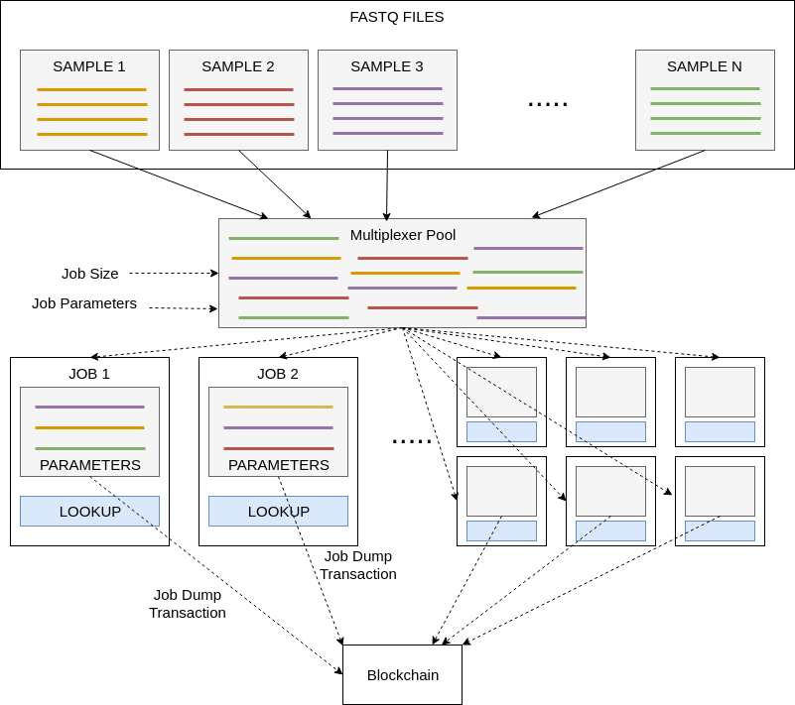
Coinami workflow
Sub-Authorities register by a transaction, signed by Main Authority
After successful transaction is included in blockchain, sub-authority can publish jobs
Jobs are created by a process called multiplexing
Job Dump transaction is also a special transaction for Coinami, consists of reward amount, job ID and supplying sub-authority

Slide 34
Coinami system
Users can either participate passively, as a miner or power
Power users deposit some amount of coins to proof their intention for working
Job assignment procedure is triggered at every five blocks
A job is assigned if the assignee has no other assignment and s/he deposited at least the amount of reward
Ten blocks after assignment, the deposit is burned if results are not yet delivered
This is for preventing spam

Slide 35
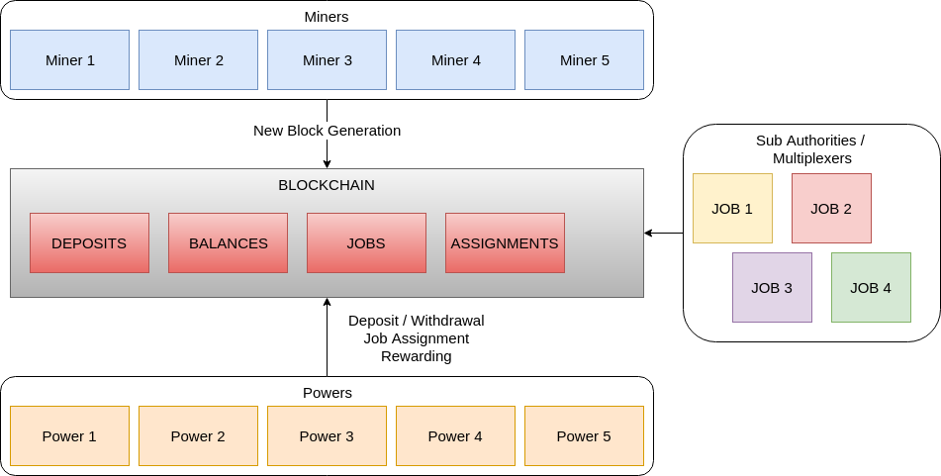
Coinami system
cryptocurrency
work distribution
Notes:
This is the perspective of an average user. It is clear that blockchain is the medium between all parties. Blockchain handles all the transactions and acts as distributed database

Slide 36
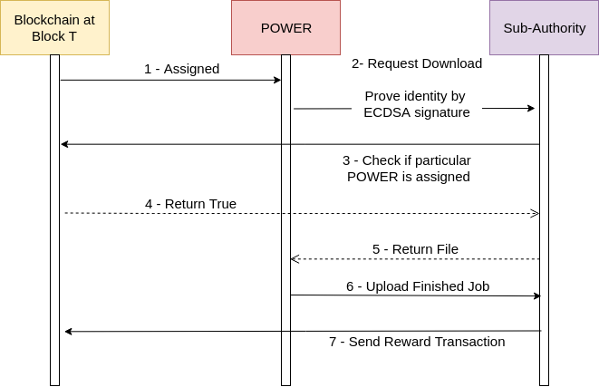
Coinami system
Power user:
Aligns with BWA
Reports back with sorted and duplicate-marked BAM
Verification - Verifybam
Using CIGAR, MD fields to rematch to the reference
BAMhash to check FASTQ vs BAM
A lookup table to demux
Rewarding
Sub-Authority publishes a reward transaction
These transactions can be verified by everyone using ECDSA signature

Slide 37
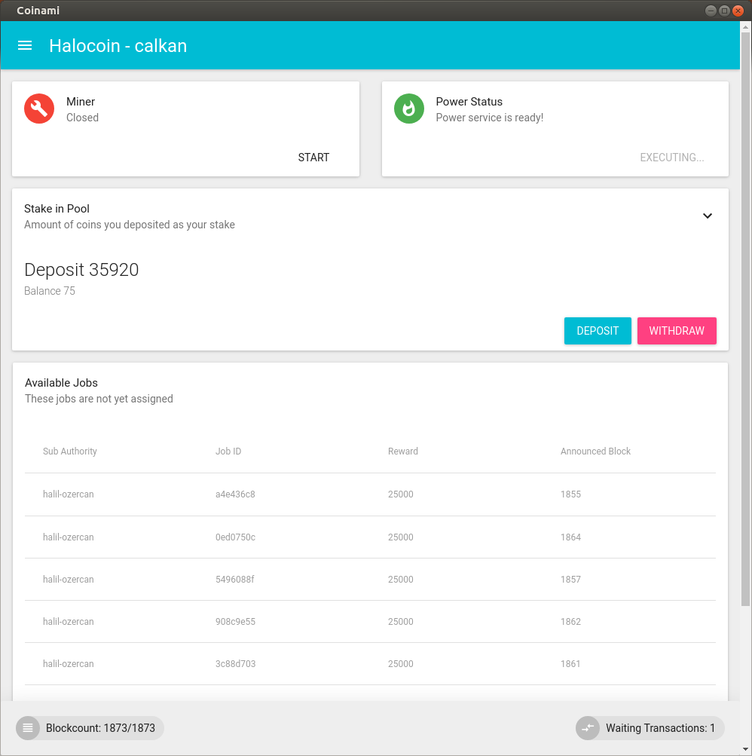
Coinami implementation
Dependencies and Cross Platform Support
Docker containers
Extendible for graph alignment or any other alternative
Common Workflow Language for easy parameterization
Python blockchain written from scratch
Main idea can be implemented in Ethereum as a Smart Contract
User client is available for Linux (Electron)
Soon to be Docker-ized

Slide 38
Coinami performance test
40x Whole Genome; ~800M read pairs
Tasks are divided to be 5M read pairs
Multiplexing and compressing: ~117 minutes
Distribution, mapping, reupload: ~20 minutes per client
Includes download and upload
Processor i7-7700HQ; 8 cores
Approximately 30 nodes. Close to bandwidth limit
160 tasks, takes around 5.3 tours of assignment
Verification & demultiplexing: ~60 minutes

Slide 39
Coinami performance test
117 + 5.3*20 + 60 = 4 Hours 43 Minutes
One whole genome alignment under 5 hours.
Better server architecture and more volunteers will only improve these numbers

Slide 40
Conclusions
HTS data is monotonically increasing
Computational analysis is the bottleneck
Additional burden due to reference updates
But (fortunately) embarrassingly parallel problem
Volunteer grids may help
“Market will decide”
Coins give motivation to miners since alignment is compute intensive
Decentralized transaction with centralized mining

Slide 41
Resources
Preprint / early version of Coinami:
https://arxiv.org/abs/1602.03031
Coming soon (hopefully)
Ozercan et al., “Realizing the potential of blockchain technologies in genomics”, Genome Research

Slide 42




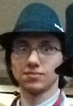



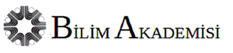
Acknowledgements
Original Coinami group
Atalay Mert İleri (now at MIT)
Halil İbrahim Özercan (now MSc student)
Alper Gündoğdu (now at Google)
Ahmet Kerim Şenol (now at Google)
M. Yusuf Özkaya (now at Georgia Tech)
Alkan Group @ Bilkent
Fatma Kahveci
Mohammed Alser
Arda Söylev
Halil İbrahim Özercan
Fatih Karaoğlanoğlu
Ezgi Ebren
Tuğba Doğan
Balanur İçen
Zülal Bingöl
Emre Doğru
Alim Gökkaya

Slide 43
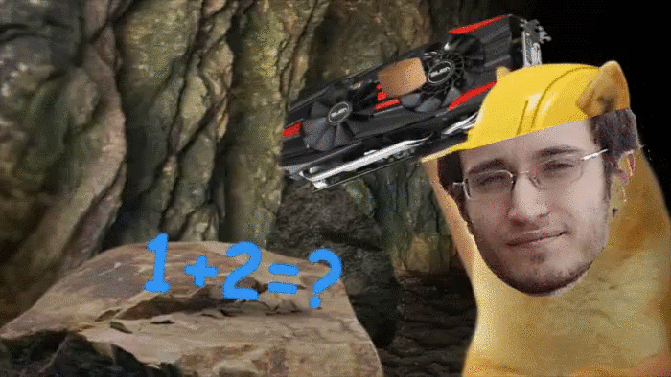
Minin’, minin’, minin’
Though the reads are mappin’
Keep them coins signing’
Rawhide!

